Slide 1
CS 5402 Introduction to Data Mining
Data Mining Methods - ID3
v.1.1
Perry B. Koob, koobp@mst.edu

Slide 2
What we are going to learn.
Decision Tree
Information Calculation
Information Gain
ID3

Slide 3
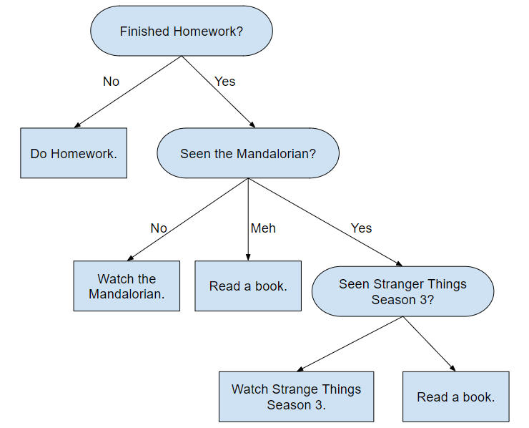
Decision Trees

Slide 4
Decision Trees
Node
Leaf
Branch

Slide 5
Decision Trees
Attribute
Class
Attribute Label (Value)

Slide 6
The Question is, which attribute do we split the data on first?

Slide 7
ID3
Iterative Dichotomiser
Developed by Ross Quinlan in 1986
Induction of decision trees
Works with Nominal Data

Slide 8
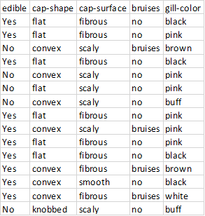
ID3
We take the attributes of our examples and create nodes. Then we create branches for each value of the attribute.
Then we determine the classes of the examples that pass through each branch.
Then we use an Information calculation to determine the attribute with the most information gain.

Slide 9
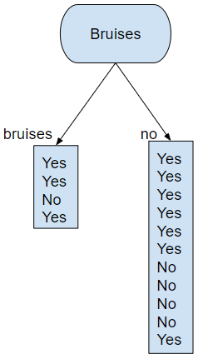
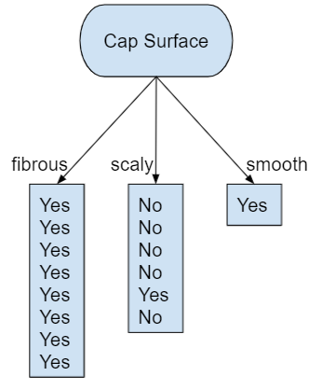
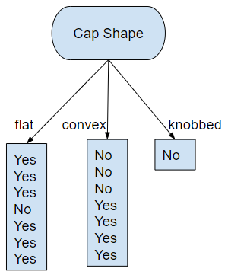
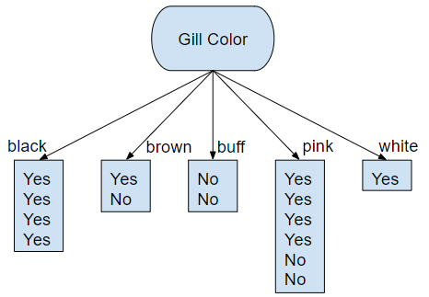
ID3

Slide 10
Information Calculation
Information calculations are based on the Shannon Entropy from Claude Shannon’s 1948 paper "A Mathematical Theory of Communication".
Info[x₁,x₂,...,x_{n}] = -Σp(x_{i})log₂(p(x_{i})) where i = 1,...,n
Info[x,y] = - p(x) * log₂(p(x)) + - p(y) * log₂(p(y)) bits
These Information calculations may be used in Feature Reduction.

Slide 11
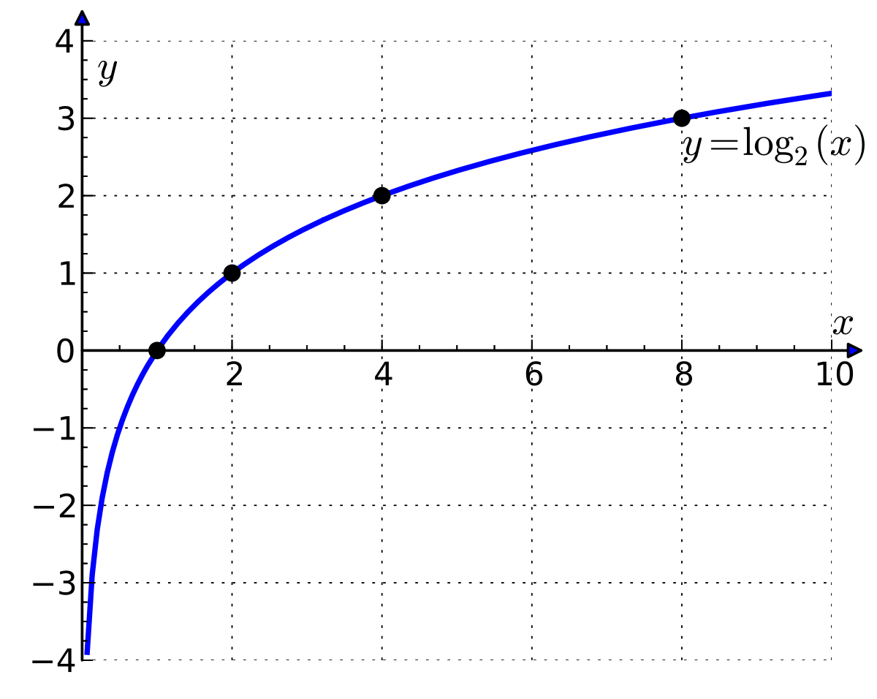
Information Calculation
Information calculations are based on the Shannon Entropy from Claude Shannon’s 1948 paper "A Mathematical Theory of Communication".
Info[x₁,x₂,...,x_{n}] = -Σp(x_{i})log₂(p(x_{i})) where i = 1,...,n
Info[x,y] = - p(x) * log₂(p(x)) + - p(y) * log₂(p(y)) bits
Notice the log base 2.
This means when p(x_{i}) = 1 , then log2(1) = 0,
and when p(x_{i}) = 0 , then log2(0) = undefined.

Slide 12
Information Calculation
Info[10,5]
We can end up with this situation when our split has a clear classification. For example Info[1,0] or Info[8,0].
If you try to calculate the Info of a clear classification you get an undefined number.
Info[1,0] = - 0/1 * log₂(1/1) - 1/1 * log₂(0/1)
= 0 - Undefined
In these cases, we say Information = 0
Info[1,0]
Info[1,5]
Info[8,0]

Slide 13
Information
Info[10,5]
Info[10,5]
Info[10,5]
Info[1,0]
Info[3,1]
Info[10,5]
Info[1,5]
Info[8,0]
Info[7,4]
Info[0,1]
Info[1,0]
Info[1,1]
Info[0,2]
Info[4,0]
Info[6,1]
Info[4,3]
Info[4,2]

Slide 14
Information Gain
Info[10,5]
We use these information calculations to determine the Information Gained from splitting on each attribute.
Gain = I - IA
Where:
I = the information the node needs to classify new examples.
IA = the average expected information needed to classify a new example after they go through the node.
Info[3,1]
Info[7,4]

Slide 15
Information Gain
Info[10,5]
We use these information calculations to determine the Information Gained from splitting on each attribute.
Gain = I - IA
Where:
I = the information the node needs to classify new examples.
IA = the average expected information needed to classify a new example after they go through the node. This is like a weighted average of the information left to be classified in each branch after the examples travel through the branches.
Info[3,1]
Info[7,4]

Slide 16
Information Gain
Info[10,5]
Using the example here we would calculate the Information Gain for the Bruises node as follows:
Gain = I - IA = Info[10,5] - info[[3,1],[7,4]]
Info[3,1]
Info[7,4]

Slide 17
Information Gain
Info[10,5]
Using the example here we would calculate the Information Gain for the Bruises node as follows:
Gain = I - IA = Info[10,5] - info[[3,1],[7,4]]
To be able to calculate the Information Gain we need to know
Info[10,5].
Info[3,1]
Info[7,4]

Slide 18
Information Gain
Info[10,5]
Using the example here we would calculate the Information Gain for the Bruises node as follows:
Gain = I - IA = Info[10,5] - info[[3,1],[7,4]]
To be able to calculate the Information Gain we need to know
Info[10,5].
To be able to calculate Info[[3,1],[7,4]] we need to know Info[3,1] and Info[7,4].
Info[3,1]
Info[7,4]

Slide 19
Select the Node with the most Gain
These branches have fully classified the examples that go through them to the same classification. Also called a pure leaf. So these branched end in leafs.

Slide 20
Final Decision Tree
We stop when we run out of examples
(we have classified everything)
or
when we run out of attributes.
If we classify everything, there are concerns that we have overfit the training data.
We must be sure to run a test data set through our model and evaluate model performance with a confusion matrix and the values that can be generated from the confusion matrix (accuracy and error rate).

Slide 21
Information Calculation
Info[10,5]
Info[x,y] = - p(x) * log₂(p(x)) - p(y) * log₂(p(y)) bits
Info[edible,inedible]_{bruised} =
p(edible|bruised) * log2(p(edible|bruised)) -
p(inedible|bruised) * log2(p(inedible|bruised))
Info[10,5] = -10/15 * log₂(10/15) - 5/15 * log₂(5/15)
= -0.667 * -0.585 - 0.333 * -1.585 = 0.918 bits
Info[3,1]
Info[7,4]

Slide 22
Information Calculation
Info[10,5]
Info[x,y] = - p(x) * log₂(p(x)) - p(y) * log₂(p(y)) bits
Info[10,5] = -10/15 * log₂(10/15) - 5/15 * log₂(5/15)
= -0.667 * -0.585 - 0.333 * -1.585 = 0.918 bits
Info[3,1] = - 3/4 * log₂(3/4) - 1/4 * log₂(1/4)
= - 0.75 * - 0.415 - .25 * -2 = 0.311 + 0.5 = 0.811 bits
Info[7,4] = -7/11 * log₂(7/11) - 4/11 * log₂(4/11)
= -0.636 * -0.652 - 0.363 * -1.459 = 0.415 + .0.52 = 0.935 bits
Info[3,1]
Info[7,4]

Slide 23
Information Calculation
Info[10,5]
Info([3,1],[7,4]) is more of a weighted average of the info needed after the examples pass through each branch.
Info[[a₁,a₂],[b₁,b₂]] = p([a₁,a₂])*Info[a₁,a₂] + p([b₁,b₂])*Info[b₁,b₂]
Info([3,1],[7,4]) = p([3,1])*Info[3,1] + p([7,4])*Info[7,4]
= 4/15 * 0.811 + 11/15 * 0.935 = 0.902 bits
Info[3,1]
Info[7,4]

Slide 24
Information Calculation
Info[10,5]
Info[x,y] = - p(x) * log₂(p(x)) - p(y) * log₂(p(y)) bits
Info[10,5] = -10/15 * log₂(10/15) - 5/15 * log₂(5/15)
= -0.667 * -0.585 - 0.333 * -1.585 = 0.918 bits
Info[3,1] = - 3/4 * log₂(3/4) - 1/4 * log₂(1/4)
= - 0.75 * - 0.415 - .25 * -2 = 0.311 + 0.5 = 0.811 bits
Info[7,4] = -7/11 * log₂(7/11) - 4/11 * log₂(4/11)
= -0.636 * -0.652 - 0.363 * -1.459 = 0.415 + .0.52 = 0.935 bits
Info([3,1],[7,4]) = 4/15 * 0.811 + 11/15 * 0.935 = 0.902 bits
Info[3,1]
Info[7,4]

Slide 25
Information Gain Calculation
Info[10,5]
Gain = I - IA
Where:
I = the information the node needs to classify new examples.
IA = the average expected information needed to classify a new example after they go through the node.
Gain(Bruises) = Info([10,5]) - Info([3,1],[7,4]) = 0.918 - 0.902 = 0.016 bits
Info[3,1]
Info[7,4]

Slide 26
Information Gain Calculations
Gain(Cap Surface) = Info([10,5]) - Info([8,0],[1,5],[0,1])
= 0.918 - (0 + 6/15 * 0.650 + 0) = 0.918 - .26 = 0.658
Gain(Cap Shape) = Info([10,5]) - Info([6,1],[4,3],[1,0])
= 0.169
Gain(Bruises) = Info([10,5]) - Info([3,1],[7,4])
= 0.918 - 0.902 = 0.016
Gain(Gill Color) = Info([10,5]) - Info([4,0],[1,1],[0,1],[4,2],[1,0])
= 0.537

Slide 27
Information Gain Calculations
Gain(Cap Surface) = Info([10,5]) - Info([8,0],[1,5],[0,1])
= 0.658
Gain(Cap Shape) = Info([10,5]) - Info([6,1],[4,3],[1,0])
= 0.169
Gain(Bruises) = Info([10,5]) - Info([3,1],[7,4])
= 0.016
Gain(Gill Color) = Info([10,5]) - Info([4,0],[1,1],[0,1],[4,2],[1,0])
= 0.537

Slide 28

Gain
0.016
0.658
0.169
0.537
Info[1,0]
Info[3,1]
Info[1,5]
Info[0,1]
Info[8,0]
Info[7,4]
Info[1,0]
Info[6,1]
Info[4,3]
Info[1,1]
Info[0,2]
Info[4,0]
Info[4,2]

Slide 29
Select the Node with the most Gain
0.658
These branches have fully classified the examples that go through them to the same classification. Also called a pure leaf. So these branched end in leafs.

Slide 30
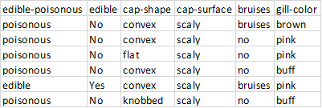
Select the Next Attribute
Now we select the next attribute with the examples that we have left that were not part of a pure leaf.

Slide 31
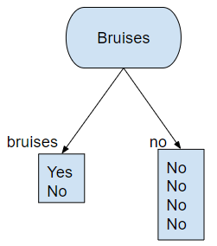
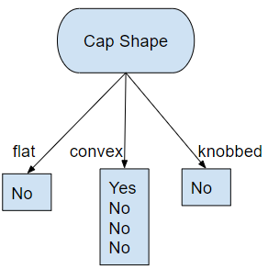
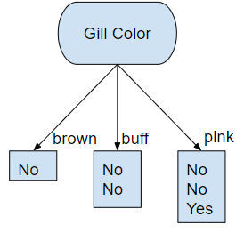
Select the Next Attribute
Info[1,5]
Info[1,5]
Info[1,5]
Info[0,1]
Info[0,1]
Info[0,1]
Info[0,2]
Info[1,1]
Info[1,2]
Info[0,4]
Info[1,3]

Slide 32
Select the Next Attribute
Info[1,5]
Info[1,5]
Info[1,5]
Info[0,1]
Info[0,1]
Info[0,1]
Info[0,2]
Info[1,1]
Info[1,2]
Info[0,4]
Info[1,3]
Gain = 0.191
Gain = 0.317
Gain = 0.181

Slide 33
Select the Next Attribute
Info[1,5]
Info[1,5]
Info[1,5]
Info[0,1]
Info[0,1]
Info[0,1]
Info[0,2]
Info[1,1]
Info[1,2]
Info[0,4]
Info[1,3]
Gain = 0.191
Gain = 0.317
Gain = 0.181

Slide 34
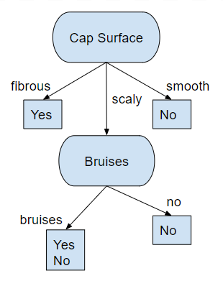
Add the New Attribute to the Decision Tree

Slide 35

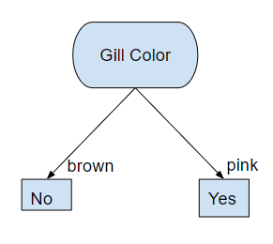
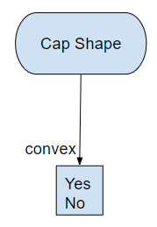
Select the Next Attribute

Slide 36
Select the Next Attribute
Info[1,1]
Info[1,1]
Info[0,1]
Info[1,0]
Info[1,1]

Slide 37
Select the Next Attribute
Info[1,1]
Info[1,1]
Info[0,1]
Info[1,0]
Info[1,1]
Gain = 1
Gain = 0

Slide 38
Select the Next Attribute
Info[1,1]
Info[1,1]
Info[0,1]
Info[1,0]
Info[1,1]
Gain = 1
Gain = 0

Slide 39
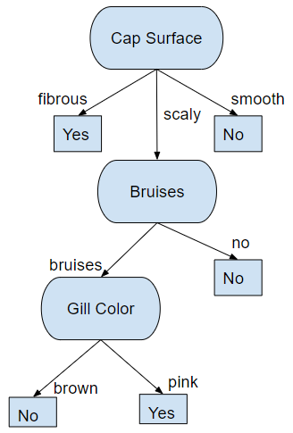
Final Decision Tree
We stop when we run out of examples
(we have classified everything)
or
when we run out of attributes.
If we classify everything, there are concerns that we have overfit the training data.
We must be sure to run a test data set through our model and evaluate model performance with a confusion matrix and the values that can be generated from the confusion matrix (accuracy and error rate).

Slide 40
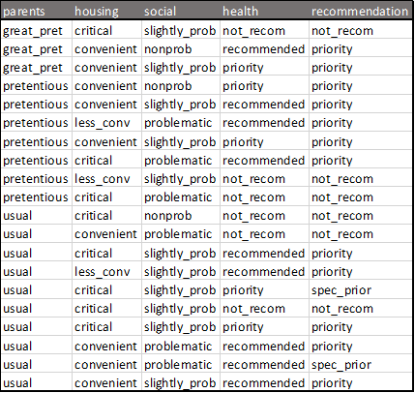
Multiclass Information Calculations

Slide 41
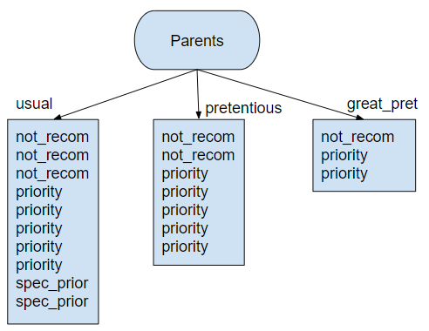
Multiclass Information Calculations

Slide 42
Multiclass Information Calculations
Info[6,12,2]
Info[1,2,0]
Info[2,5,0]
Info[3,5,2]

Slide 43
Multiclass Information Calculations
Info[6,12,2 ] = - 6/20 * log₂(6/20) - 12/20 * log₂(12/20) - 2/20 * log₂(2/20) = 1.295
Info[3,5,2] = - 3/10 * log₂(3/10) - 5/10 * log₂(5/10) - 2/10 * log₂(2/10) = 1.485
Info[2,5,0] = - 2/7 * log₂(2/7) - 5/7 * log₂(5/7) - 0/7 * log₂(0/7) = 0
Info[1,2,0] = - 1/3 * log₂(1/2) - 2/3 * log₂(2/3) - 0/3 * log₂(0/3) = 0
Info[[3,5,2],[2,5,0],[1,2,0]] = 10/20 * 1.485 + 7/20 * 0 + 2/20 * 0 = 0.743
Gain = Info[6,12,2 ] - Info[[3,5,2],[2,5,0],[1,2,0]] = 1.295 - 0.743 = 0.552

Slide 44
What we covered.
Decision Tree
Information Calculation
Information Gain
ID3

Slide 45
References
Han, J., Kamber, M., & Pei, J. (2011). Data mining concepts and techniques third edition. Morgan Kaufmann.
Quinlan, J. R. (1986). Induction of decision trees. Machine learning, 1(1), 81-106.
Shmueli, G., Bruce, P. C., Yahav, I., Patel, N. R., & Lichtendahl Jr, K. C. (2017). Data mining for business analytics: concepts, techniques, and applications in R. John Wiley & Sons.
Witten, I. H., Frank, E., Hall, M. A., & Pal, C. J. (2016). Data Mining: Practical Machine Learning Tools and Techniques.

